Slide 1


Milestone One
Team: Grant Burke, Hanson Chaney, Cooper Newlin, Chris Turner

Slide 2

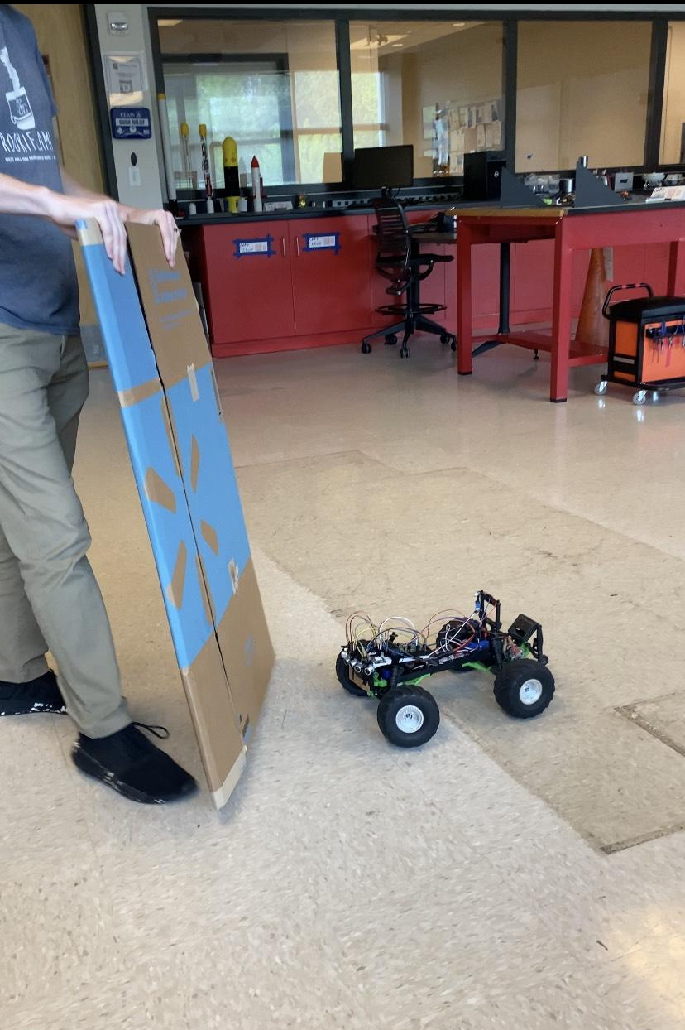
Timeline From Last Semester to Now
Goal in May was to implement a Raspberry Pi with our RC car with plans of adding GPS
Since then, we changed our direction with the hardware used
Our project is a proof of concept for an auto-following cart

Slide 3

Milestones
Working Bluetooth receiver serial communication to Raspberry Pi
Working Bluetooth communication between mobile app and Raspberry Pi
First draft of mover chassis in Fusion 360

Slide 4
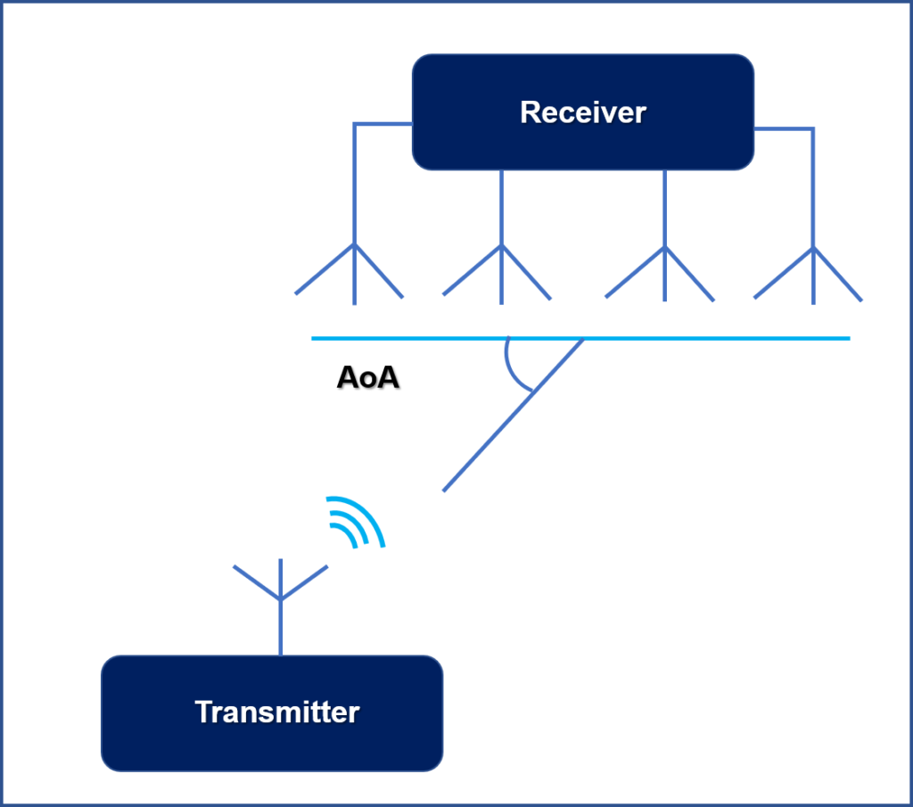
Bluetooth Direction Finding
GPS unviable due to insufficient accuracy for use-case without using RTK.
Other RTLS options unappealing
Solution: use Bluetooth Direction Finding
Angle of Arrival
Uses single transmitter + receiving antenna array to calculate direction.

Slide 5
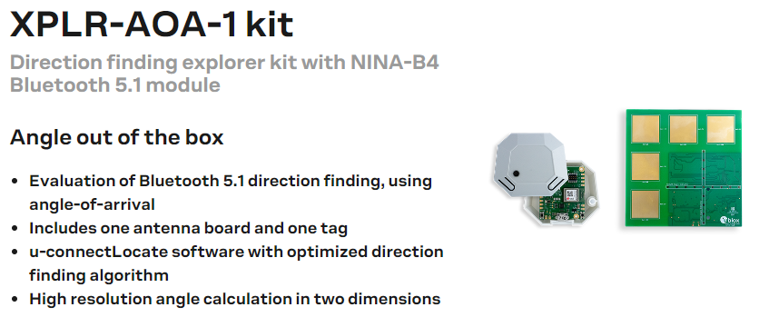
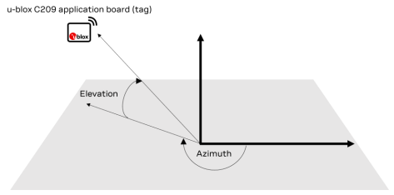
Bluetooth Direction Finding
U-blox XPLR-AOA-1 development kit
Calculate angle between receiver board and tag.
Report angles + other info to Raspberry Pi over USB or UART.

Slide 6
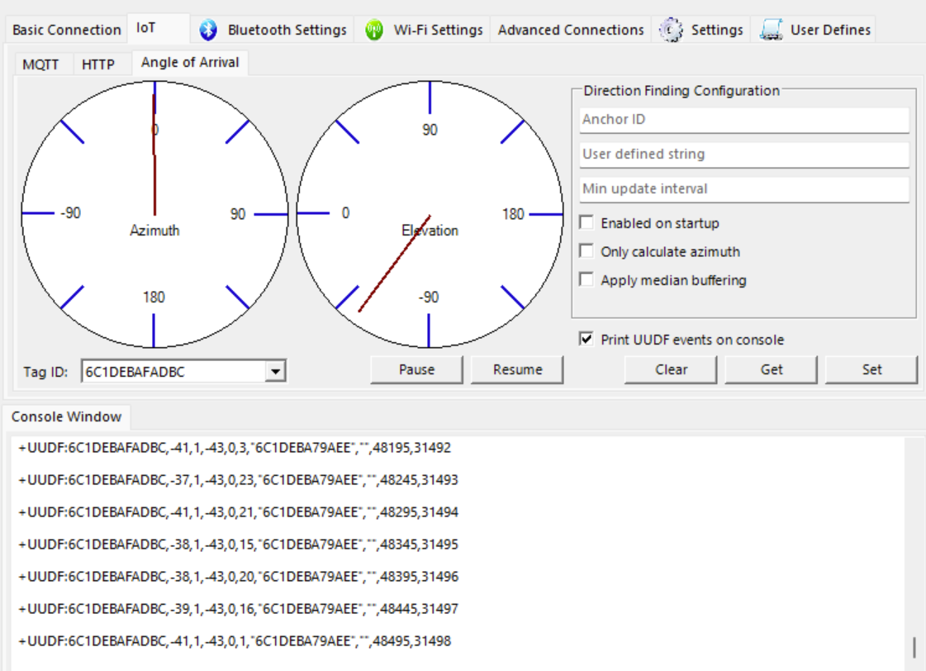
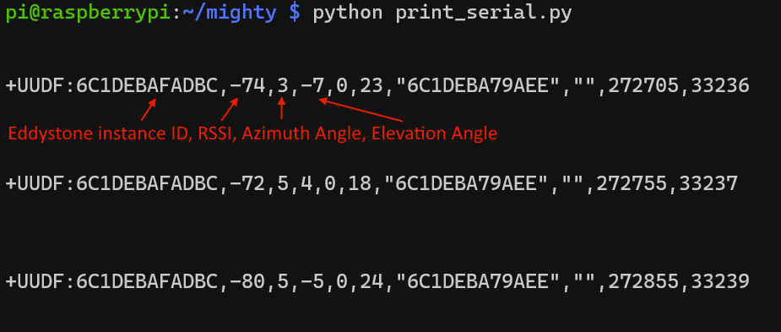
Showing Serial Communication
Configuration
via USB on Raspberry Pi

Slide 7
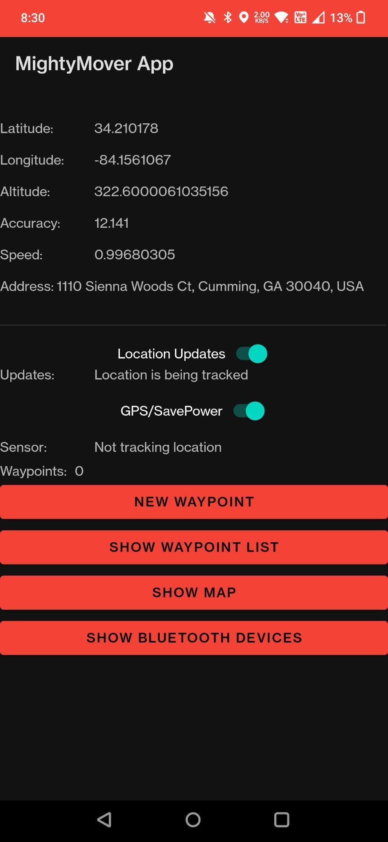
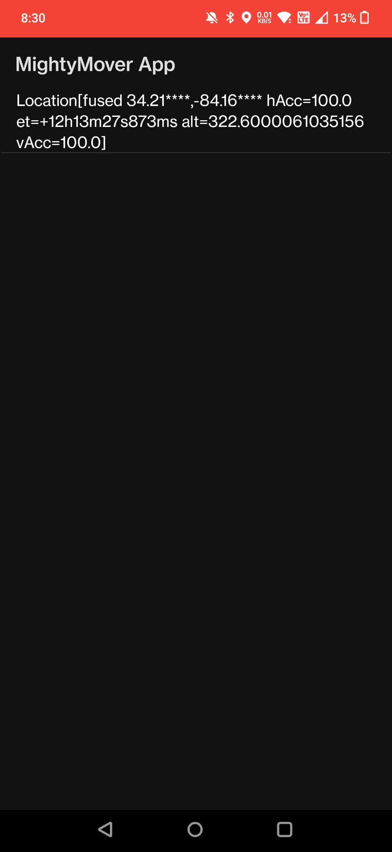
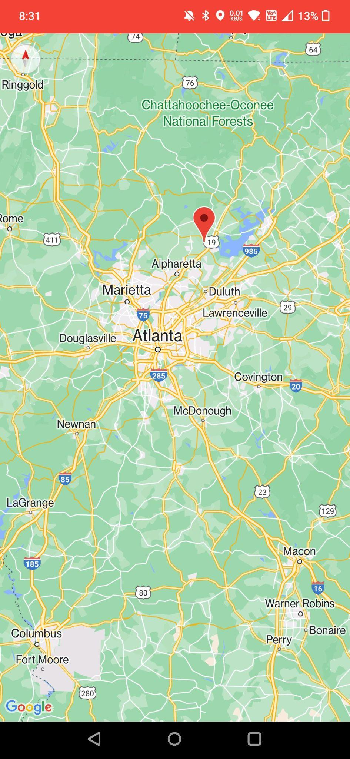
Mobile App Communication
GPS no longer feasible, app will now be a monitor
The app will now show info about the mover like battery, mode, orientation etc.
The app makes use of Bluetooth, because the Mover operates outdoors.
We have successfully communicated between the phone and the Pi.

Slide 8
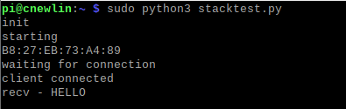
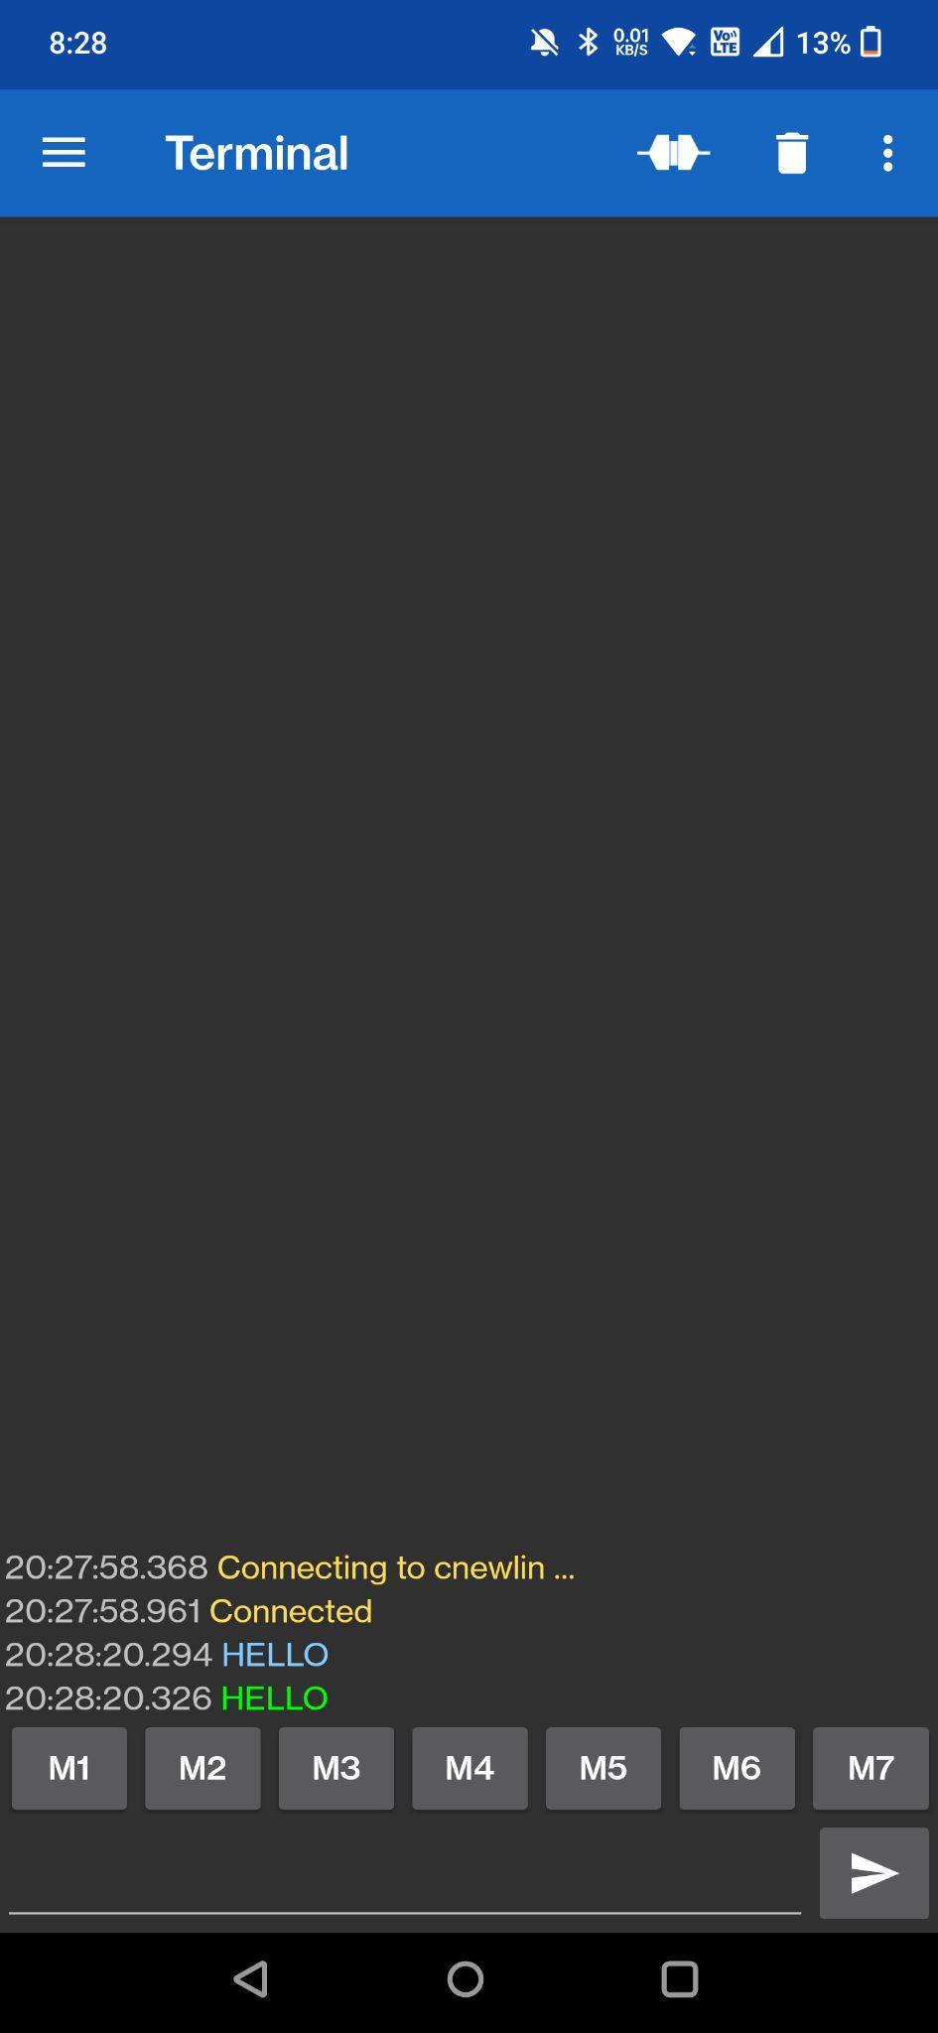
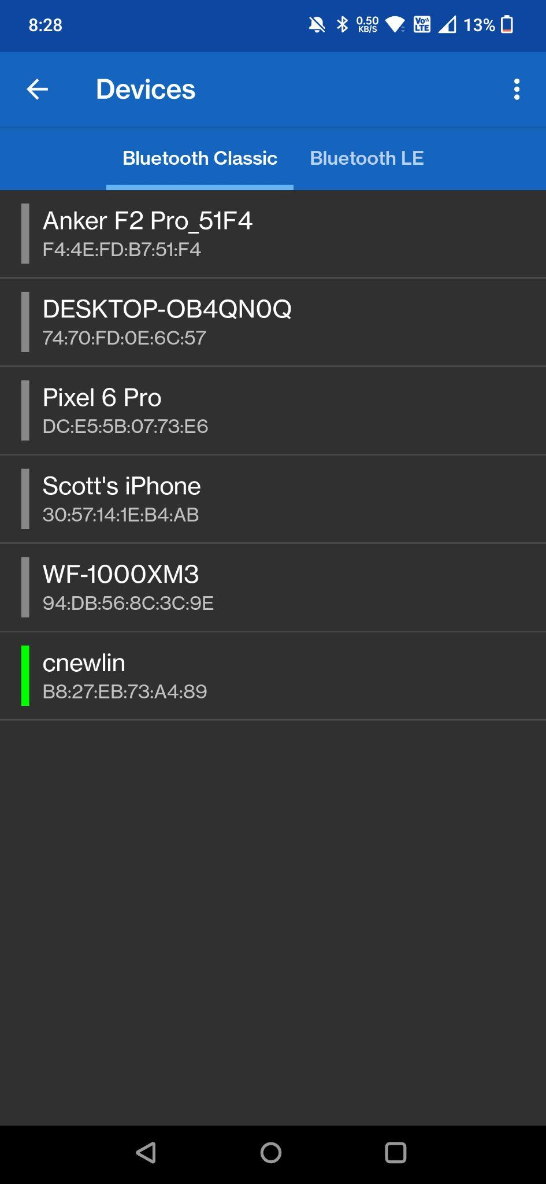
Bluetooth Communication
We will make use of the serial port profile (SPP)
Sending basic things like strings and integers
The phone must be the server, and the Pi the client
We plan to include similar features to this app in our own app

Slide 9
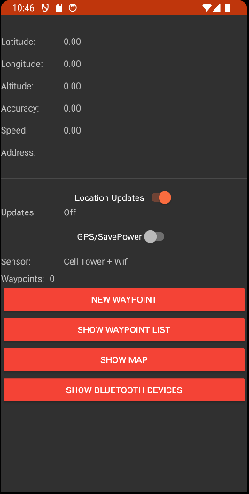
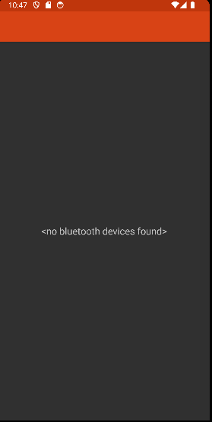
Bluetooth Communication
With a test app found via GitHub, we were able to have successful communication
The next task was to implement this app
This became a massive headache

Slide 10
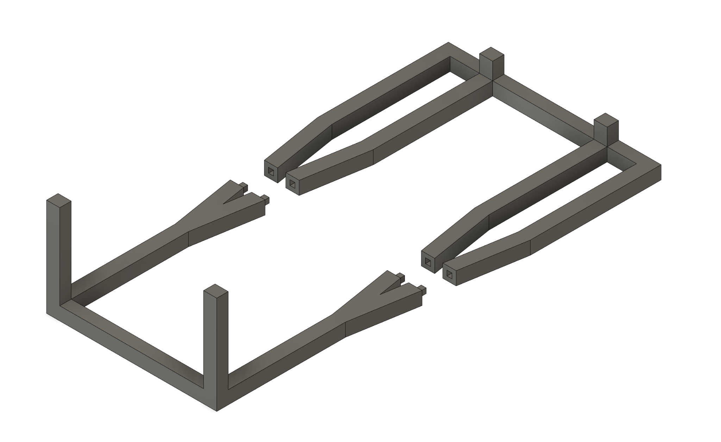
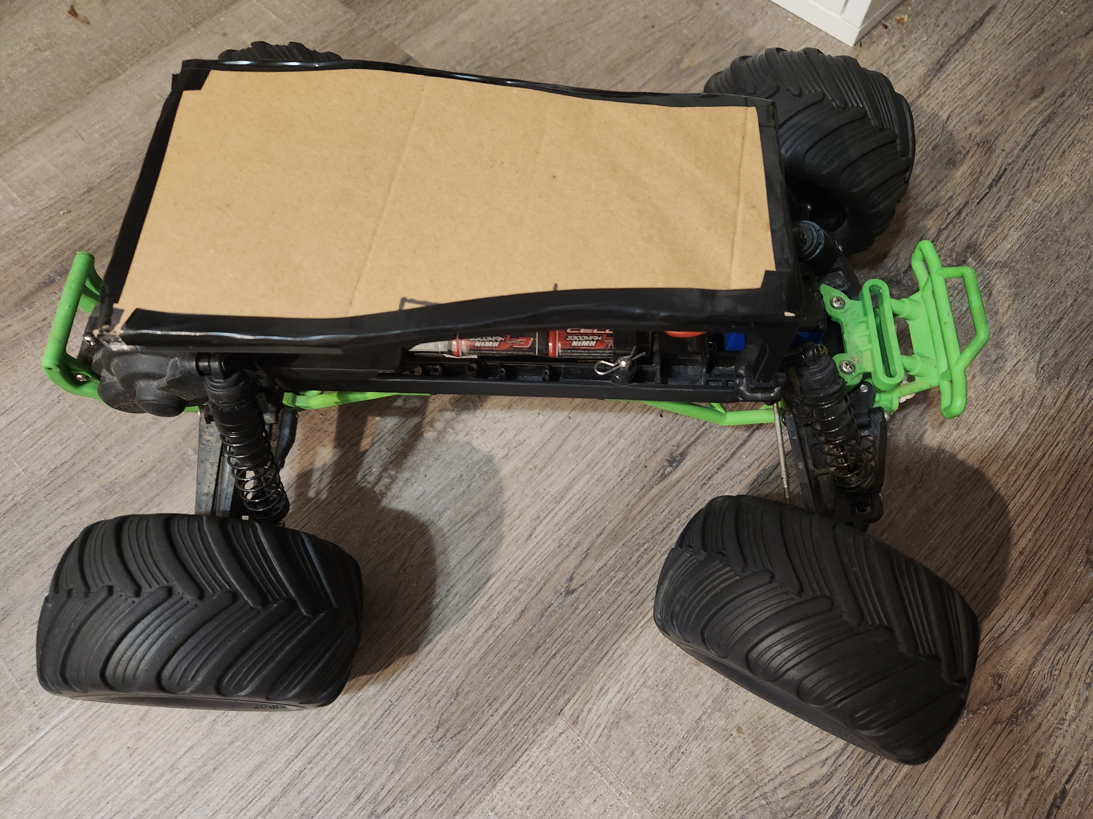
Chassis Design - Draft
Needs to be able to be 3D printed.
Integrate with existing mounting points on RC car.
Easy to put on and take off.
Not fragile.

Slide 11
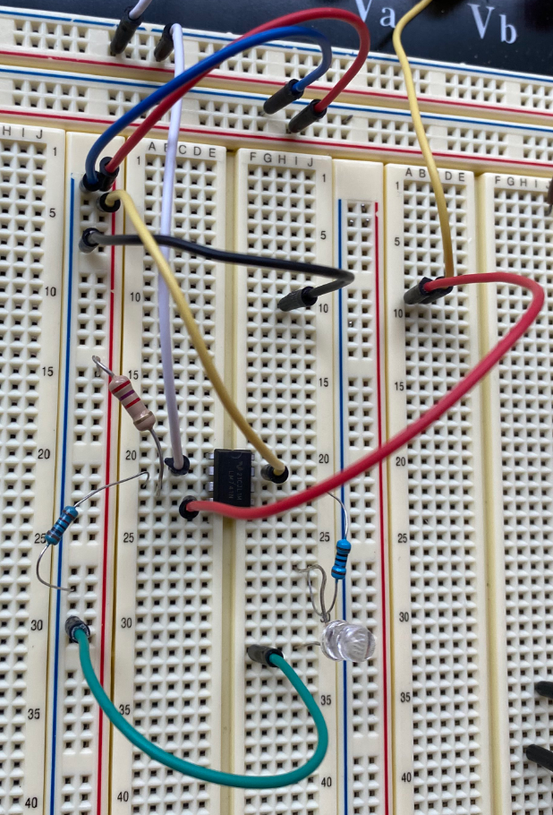
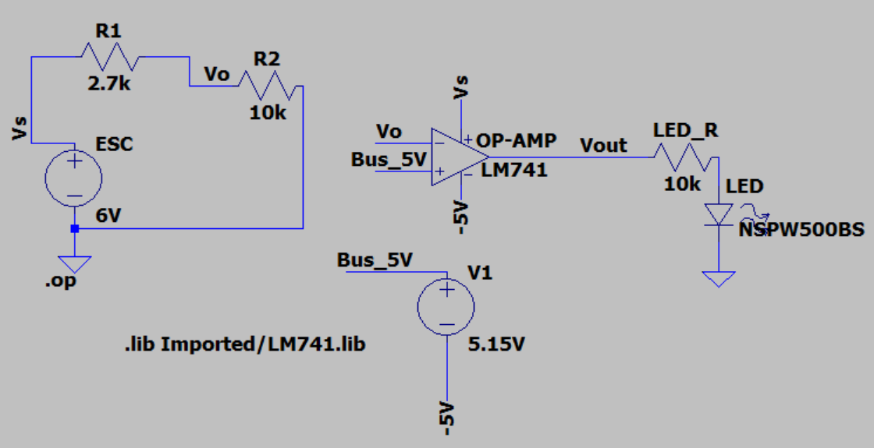
Added Circuits to Our Project
Our second circuit tells the user that the battery needs charging.
The benefits include:
Components running at optimal voltages (4.75V to 5.2V)
Alerting the user of low battery

Slide 12
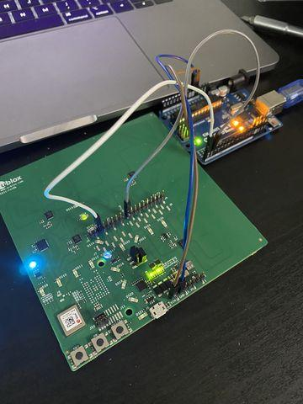
Difficulties Encountered
Getting data from receiver from UART instead of USB.
Processing serial data from receiver in near real-time

Slide 13
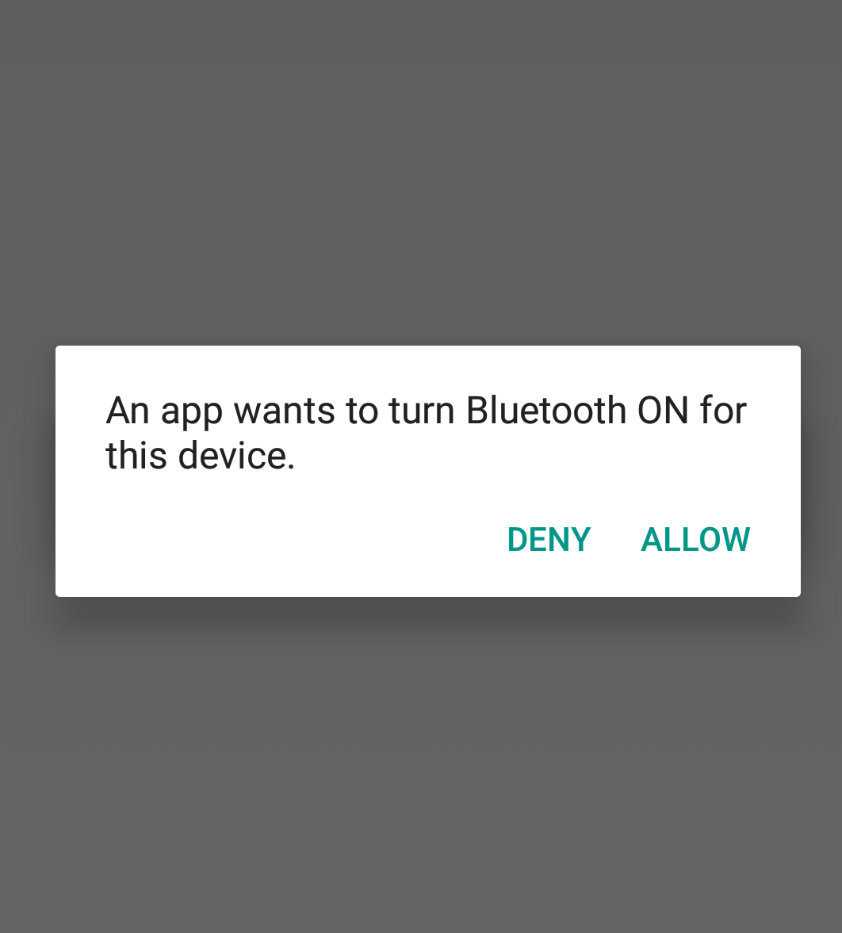
Difficulties Encountered
Programming an app for Android has a massive learning curve.
Bluetooth communication is tricky and has lots of factors that need to be taken into account, like profile, MAC address, UUID, port, sockets, etc.

Slide 14
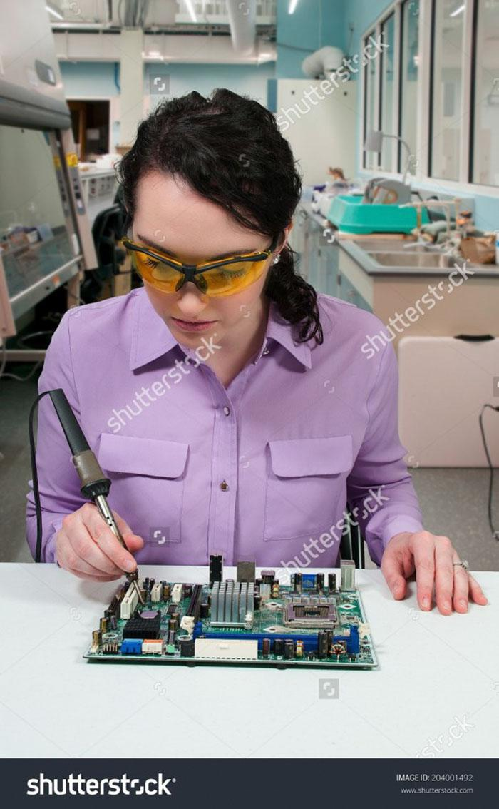
Our Plan Ahead?
Full implementation of the bluetooth module and RC car
Improve the app’s appearance
Create a draft of PCB design
Start on designing a final 3D model

Slide 15
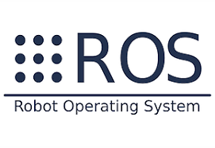
Our Plan Ahead?
Full system integration with ROS (Robot Operating System)
ROS is an open source SDK for robotics applications.
It’s a standard software platform for developers that is used in research, prototyping, deployment, and production.

Slide 16
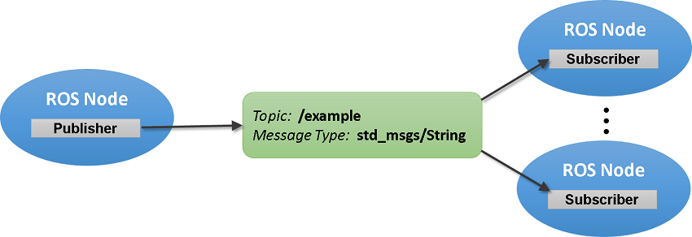
Robot Operating System
Publisher/subscriber system (similar to MQTT)
Handle communication between systems in a more standard way
Provides additional functionality for hardware abstraction, device drivers, and more.
Enables switch to different hardware more easily.

Slide 17

Thank You

